Slide 1

CSE413 – Security of Information Systems 2020 PhD Furkan Gözükara, Toros University https://github.com/FurkanGozukara/Security-of-Information-Systems-CSE413-2020
Lecture 6
Computer Security
Composed from Prof. Audun Jøsang, University of Oslo, Information Security 2018 Lectures
Source : https://www.uio.no/studier/emner/matnat/ifi/INF3510/v18/lectures/

Slide 2
Lecture Overview
Secure computer architectures
Virtualization architectures
Trusted computing

Slide 3

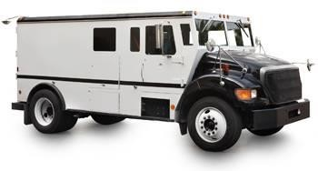

System & Communication Security
"Using encryption on the Internet is the equivalent of arranging an armored car to deliver credit card information from someone living in a cardboard box to someone living on a park bench.“
(Gene Spafford)

Slide 4
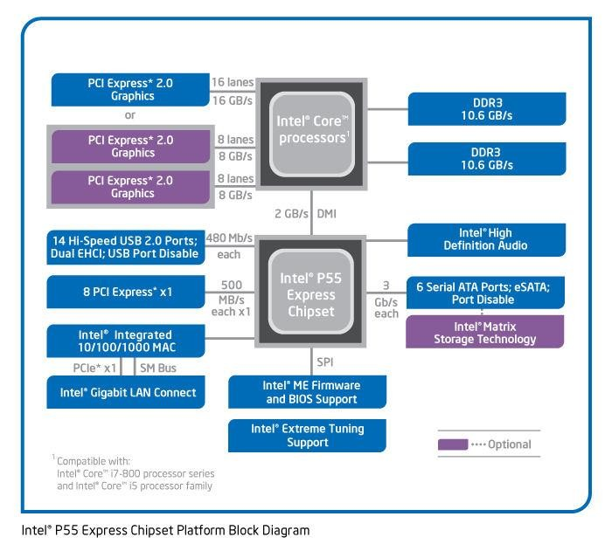
Vulnerabilities of the PC today
Vulnerable
to sw
attacks
Vulnerable to sw attacks
Vulnerable to sw attacks
Vulnerable to sw attacks

Slide 5
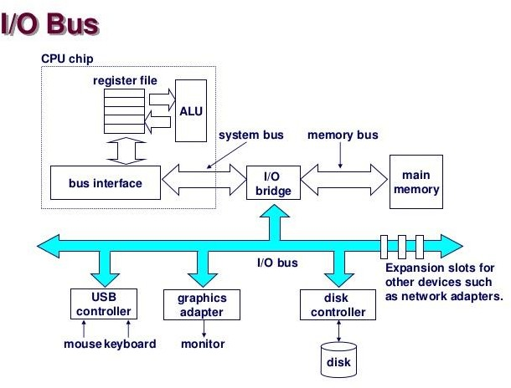
Vulnerabilities of the PC today
Access to process memory: most of the attacks are carried out this way!!!
Access to protected memory through DMA
Access to keyboard or mouse data
Access to graphics frame buffer
Insert malicious code into file that will be executed later

Slide 6
Approaches to strengthening platform security
Harden the operating system
SE (Security Enhanced) Linux, Trusted Solaris, Windows 7/8/10
Add security features to the CPU
Protection Layers, NoExecute, ASLR
Virtualisation technology
Separates processes by separating virtual systems
Trusted Computing
Add secure hardware to the commodity platform
E.g. TPM (Trusted Platform Module)
Rely on secure hardware external to commodity platform
Smart cards
Hardware tokens

Slide 7
OS protections – Launching a process
When the system runs an executable, the code and the data of the executable are loaded into the Random Access Memory
The OS analyze the code and also copies the required dependencies and the necessary OS API files into the memory
Each process has an own Virtual Address Space, where all necessary code and data are loaded
The process can access only its own Virtual Address Space by CPU instructions

Slide 8
OS protections – Process Virtual Address Space
The process code can access its own address space, but this addressing is different from the global physical addressing. Each process has the maximum addressable memory range: a virtual memory in a virtual address space (this is 232 (4GB) i.e. in 32bit systems 0x00000000 – 0xffffffff)
To ensure the correct memory operations the OS has to provide a runtime address translation between virtual memory to the physical memory

Slide 9
OS protections – Process Virtual Address Space
Because of this way of operation the OS provides 2 protections by design: The program code that is executed cannot access the physical memory directly (We cannot write code to access physical memory in none of the programming languages)
And also the OS protects the process code and data from each other. Normally a process cannot have access to another process memory (except debugging a process by another process or using specific OS features such as CreateRemoteThread)

Slide 10
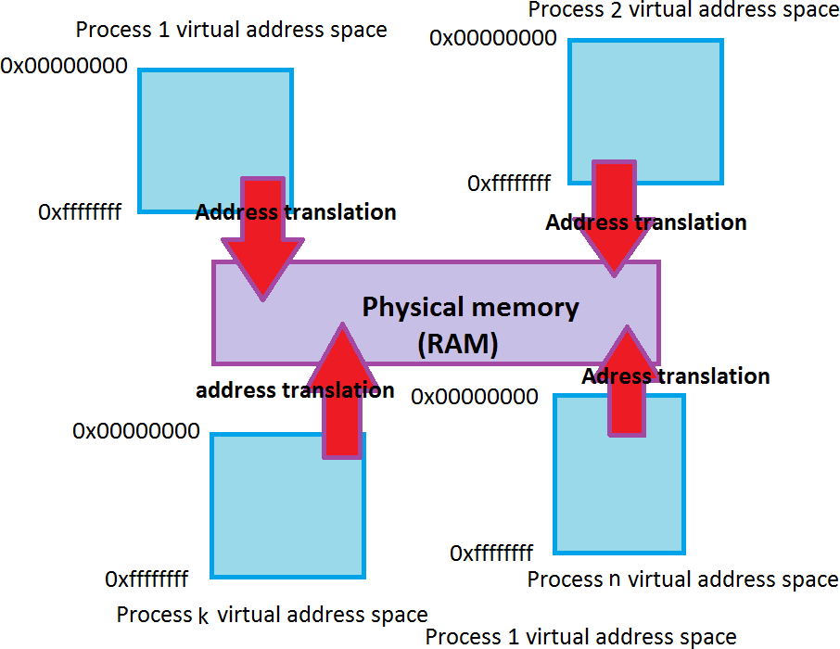
OS protections – Runtime Address Translation
- The runtime address translation is to optimize memory usage of processes and also to protect the process data

Slide 11
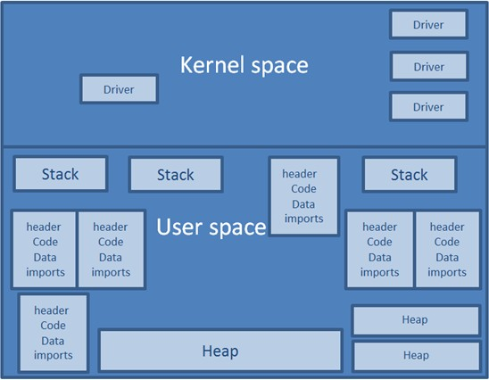
OS protections – Virtual Address Space
- The Virtual Address Space is separated into kernel and user space

Slide 12
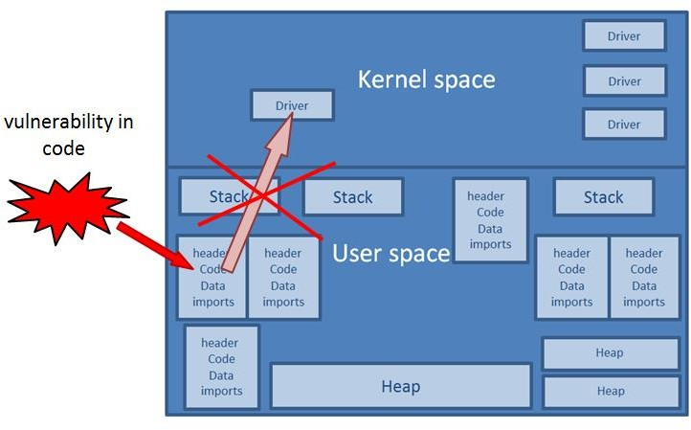
OS protections – Code vulnerabilities
- The kernel space can be accessed through only specific OS APIs (e.g. in Windows using the native API, Hardware protection CPU rings - see later)
Ntdll.dll
Kernelbase.dll

Slide 13
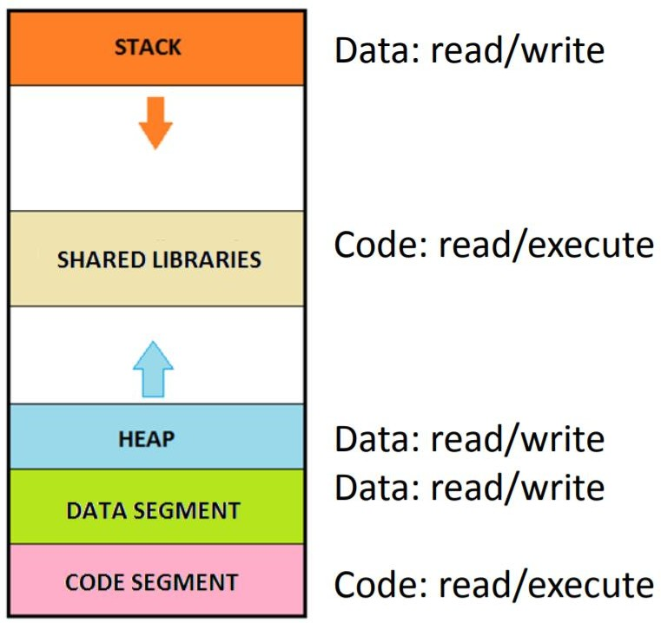
OS protections – Software supported Data Execution Prevention (DEP)
- The vulnerable code has no access directly to kernel space, but without DEP it can modify the code in the user space (even the OS API in user space) or can execute an attacker placed malicious code
- The OS can enforce DEP (i.e nxAlwaysOn settings on Windows)

Slide 14
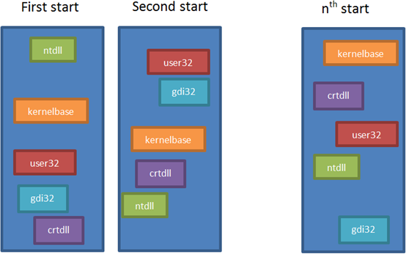
OS protections – Address Space Layout Randomization (ASLR)
- Because of DEP the attackers turned into code reuse. To prevent it OS provides code randomization in the Virtual Address Space

Slide 15
OS advanced protections – new directions
Increasing the entropy of ASLR makes brute-forcing less effective (High Entropy ASLR)
Address Space Layout Permutation (ASLP) the place of the libraries are randomized as well as the order of the methods in the Virtual Address Space
Code diversity (OS protection ?)

Slide 16
OS advanced protections – new directions
Multiple heaps and protected heap segments (e.g. late free, MS Edge)
Execute no Read segments (XnR protection, hardware support later?)
Control Flow Integrity (observation of unintended use-cases)

Slide 17
CPU protection
Protection rings
Hardware supported Data Execution Prevention
Hardware supported Control Flow Integrity (not in use yet, e.g. Intel’s Control Flow Enforcement)
Intel sgx (Protecting memory regions from higher
privileged access)

Slide 18
Reference Monitor
A reference monitor is any security model for enforcing an access control policy over subjects' (e.g., processes and users) ability to perform operations (e.g., read and write) on objects (e.g., files, memory and sockets) on a system.
The reference monitor must always be invoked (complete mediation).
The reference monitor must be tamperproof (tamperproof).
The reference monitor must be small enough to be subject to analysis and tests, the completeness of which can be assured (verifiable).
The security kernel of an OS is a low-level (close to the hardware) implementation of a reference monitor.
Reference
monitor
?
Request
access
Grant access
Subject
Object
Deny access

Slide 19
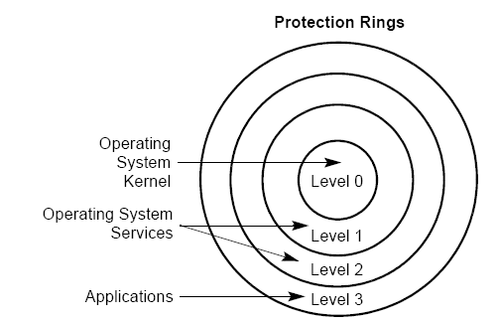
OS security kernel as reference monitor
Hierarchic security levels were introduced in X86 CPU architecture in 1985 (Intel 80386)
4 ordered privilege levels
Ring 0: highest
Ring 3: lowest
Intended usage → see diagram:
17

Slide 20
What happened to rings 1 & 2 ?
... it eventually became clear that the hierarchical protection that rings provided did not closely match the requirements of the system programmer and gave little or no improvement on the simple system of having two modes only. Rings of protection lent themselves to efficient implementation in hardware, but there was little else to be said for them. [...]. This again proved a blind alley...
Maurice Wilkes (1994)
18

Slide 21

CPU Protection Ring structure from 2006
New Ring -1 introduced for virtualization.
Necessary for protecting hypervisor from VMs (Virtual Machines) running in Ring 0.
Hypervisor controls VMs in Ring 0
Ring 0 is aka.: Supervisor Mode
Ring -1: Hypervisor Mode -v1
Ring 0: Kernel Mode (Unix root, Win. Adm.) 0 Ring 1: Not used 1 Ring 2: Not used 2 Ring 3: User Mode 3
19

Slide 22
Privileged Instructions
Some of the system instructions (called “privileged instructions”) are protected from use by application programs.
The privileged instructions control system functions (such as the loading of system registers). They can be executed only when the Privilege Level is 0 or -1 (most privileged).
If one of these instructions is attempted when the Privilege Level is not 0 or -1, then a general-protection exception (#GP) is generated, and the program crashes.
22

Slide 23

Principle of protection ring model
A process can access and modify any data and software at the same or less privileged level as itself.
A process that runs in kernel mode (Ring 0) can access data and SW in Rings 0, 1, 2 and 3
but not in Ring -1
The goal of attackers is to get access to kernel or hypervisor mode.
through exploits
by tricking users to install
SW
Ring 3
Data
Ring 2
Data
Ring 1
SW
Ring 0
SW
SW
Data
Ring -1 Data
SW
software
23

Slide 24
User processes access to system resources
User processes need to access system resources
(memory and drivers)
User application processes should not access system memory directly, because they could corrupt memory.
The CPU must restrict direct access to memory segments and other resources depending on the privilege level (Current Privilege Level, CPL).
Question 1: How can a user process execute instructions
that require kernel mode, e.g. for writing to memory ?
Answer: The CPU must switch between privilege levels
Question 2: How should privilege levels be switched?
Answer: Through Controlled invocation of code segments
22

Slide 25
Controlled Invocation of code segments
Code segment of user process
1
Call Gate
Ring 3
4
Rings 1 & 2 (no code segments)
3
2
Ring 0
Driver
Code Segments
Kernel
Code Segments
Ring -1
Hypervisor
Code Segments
25

Slide 26
Controlled Invocation
The user process executes code in specific code
segments.
Each code segment has an associated mode which
dictates the privilege level the code executes under.
Simply setting the mode of user process code to Kernel would give kernel-privilege to user process without any control of what the process actually does. Bad idea!
Instead, the CPU allows the user process to call kernel code segments that only execute a predefined set of instructions in kernel mode, and then returns control back to the user-process code segment in user mode.
We refer to this mechanism as controlled invocation.
26

Slide 27
Hardware supported Data Execution Prevention
Intel Processors with XD support
AMD processors with NX support
Hardware-enforced DEP marks all memory locations as non- executable (you cannot execute code in this portion of memory) unless the location explicitly contains executable code.
Hardware-enforced DEP relies on processor hardware to mark memory with an attribute that indicates that code should not be executed from that memory.
Processors that support hardware-enforced DEP are capable of raising an exception when code is executed from a memory location where it should not be executed.
To use these processor features, the processor must run in Physical Address Extension (PAE) mode. HP ships Windows XP with PAE enabled.
27

Slide 28
Control Flow Enforcement (in plan)
Processors will directly support: Shadow (call) stack tracking. Method return addresses are stored in data stack and the shadow stack too. Shadow stack is not accessible, the processor checks the return addresses, if there’s un-matching return then control protection exception is raised
Processors also support: indirect branch tracking. After each legitimate indirect branch instruction the code must contain a nop-like special instruction. If the program execution is redirected by an attacker, the nop-like instruction is missing and a control flow protection error is raised.
Control Flow Enforcement Technology is announced by
Intel in June 2016. Release date is unknown.
28

Slide 29
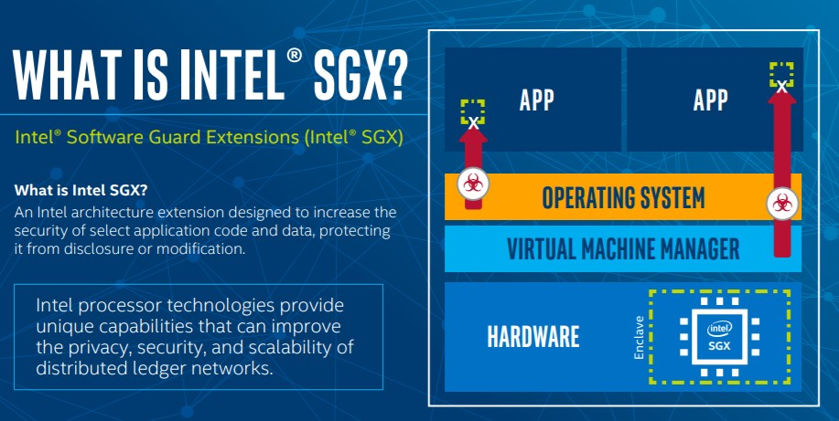
Intel Software Guard Extension (SGX)
https://newsroom.intel.com/news/intel-microsoft-enterprise-blockchain-service/
29

Slide 30
TCB – Trusted Computing Base
The trusted computing base (TCB) of a computer system is the set of all hardware, firmware, and/or
System
software components that are critical to its security, in the sense that bugs or vulnerabilities occurring inside the TCB might jeopardize the security properties of the entire system.
By contrast, parts of a computer system outside the TCB must not be able to breach the security policy and may not get any more privileges than are granted to them in accordance to the security policy
TCB
Security- Relevant Components
Components that are irrelevant for security
From TCSEC
Trusted Computer Evaluation Criteria, 1985.
30

Slide 31
Platform Virtualization

Slide 32
Platform Virtualization
Hypervisor (aka. VMM - Virtual Machine Monitor) is needed to manage multiple guest OSs (virtual machines) in the same hardware platform.
Many types of hypervisors available
VMWare is most known Commercial product (Type 1&2)
Free version comes with a limitations
VirtualBox is a hypervisor for x86 virtualization
It is freely availably under GPL, Type 2
Runs on Windows, Linux, OS X and Solaris hosts
Hyper-V is Microsoft’s hypervisor technology (Type 1)
Requires Windows Server
Xen, powerful open source hypervisor, (Type 1)

Slide 33
Type 1 VM Architecture (native)
App.
App.
App.
App.
App.
App.
Guest OS VM
e.g. Windows
Guest OS VM
e.g. Linux
Guest OS VM
e.g. Mac OS
Virtual Machines
Hypervisor
Hardware (X86 CPU from Intel or AMD)
No host OS
Hypervisor runs directly on hardware
High performance
Traditionally limited GUI, but is improved in modern versions
HW support can be an issue

Slide 34
Type 2 VM Architecture (hosted)
App.
App.
App.
App.
App.
App.
Guest OS VM
e.g. Linux
Guest OS VM
e.g. Windows
Virtual Machines
Hypervisor
Host OS (e.g. Windows, Linux or Mac OS)
Hardware (X86 CPU from Intel or AMD)
Hypervisor runs on top of host OS
Performance penalty, because hardware access goes through 2 OSs
Traditionally good GUI
Traditionally good HW support, because host OS drivers available

Slide 35
Challenges of Running VMs
VMs and Apps in a VM must not know that Hypervisor exists or that they share HW resources with other VMs
App.
App.
App.
App.
Hypervisor must protect VMs’ memory areas from each other
Guest OS VM
Guest OS VM
Hypervisor
Hypervisor must protected itself
from all VMs
Hardware
Hypervisor must present virtual hardware interface to VMs

Slide 36
Type 1 VM Architecture Ring Allocation
Ring 3
App.
App.
App.
App.
Ring 0
Guest OS VM
Guest OS VM
Run VMs in Ring 0
Ring -1
Hypervisor
Run Hypervisor in Ring -1
Hardware
Guest OS VMs are less privileged than the hypervisor.
Hypervisor is well protected from the VMs.
Good performance and good security !

Slide 37
Type 2 VM Architecture Ring Allocation
App.
App.
App.
App.
Ring 3
Guest OS VM
Guest OS VM
Run VMs in Ring 3
Hypervisor
Run Hypervisor in Ring 3
Ring 0
Host OS
Run Host OS in Ring 0
Hardware
Guest OS VMs run in Ring 3.
Guest OS VMs call privileged instructions that are forbidden in Ring 3.
Forbidden instructions cause exceptions that are handled by
interrupt/exception handler to be executed.
Slow performance !

Slide 38
Platform Virtualisation Products
Microsoft Hyper-V
VMWare ESX
Citrix XenServer (Xen)
ORACLE VM Server (Xen)
Amazon EC2 (Xen)
IBM System Z Hypervisor
Type 1
(Native)
Hypervisor types
Type 2
(Hosted)
Microsoft Virtual PC
VMWare Workstation
Citrix XenClient
VirtualBox

Slide 39
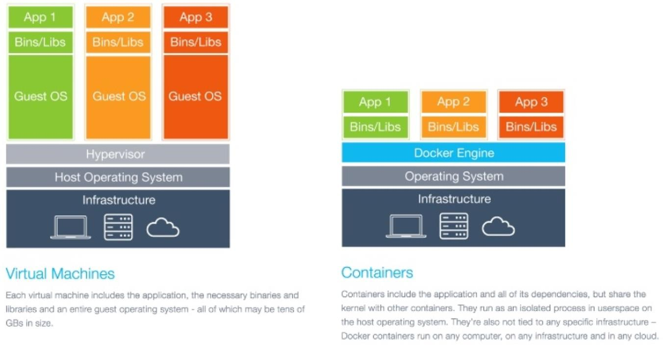
Operating system level virtualization
https://www.slideshare.net/GiacomoVacca/docker-from-scratch

Slide 40
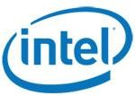
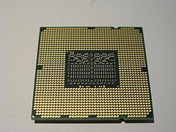
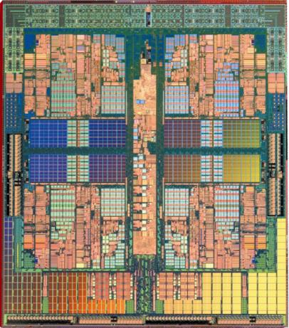

Hardware support for virtualization
Modern Intel and AMD X86 CPUs support virtualization
Intel-VT (Intel Virtualization Technology)
AMD-V (AMD Virtualization)
Must be enabled in BIOS
Can be enabled and disabled
Computers with single OS typically have virtualization disabled
Access to data- and code segments for hypervisor can
be restricted to processes running in hypervisor mode
Some instructions are reserved for hypervisor mode
AMD Phenom CPU
Intel Core i7 CPU

Slide 41
Why use platform virtualization
Efficient use of hardware and resources
Improved management and resource utilization
Saves energy
Improved security
Malware can only infect the VM
Safe testing and analysis of malware
Isolates VMs from each other
Distributed applications bundled with OS
Allows optimal combination of OS and application
Ideal for cloud services
Powerful debugging
Snapshot of the current state of the OS
Step through program and OS execution
Reset system state

Slide 42
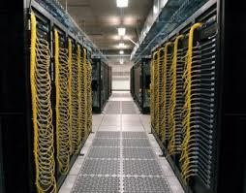
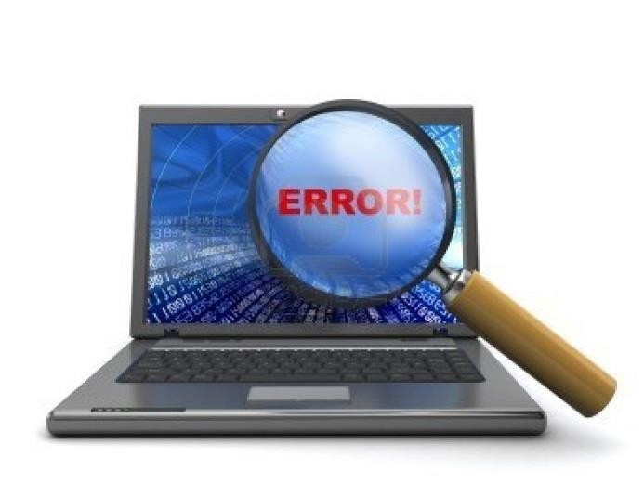
Hypervisor examples of use
Cloud providers run large server parks
Each customer gets its own VM
Many customers share the same hardware
Migrated VMs between servers to
increase/reduce capacity
Amazon EC2 Data Centre
Testing and software analysis
Potentially damaging experiments can be executed in isolated environment
Take a snapshot of the current state of the OS
Use this later on to reset the system to that state
Malware Analysis

Slide 43

Trusted Computing

Slide 44

Trusted Computing Motivation
Software alone can not be trusted.
Malware infection in OS kernel remains undetected
by anti-malware tools.
Physical access to computers opens up for attacks that can circumvent traditional TCBs (Trusted Computing Base), e.g. secure operating systems.
Remote parties do not know the status of systems
they are communicating with.
Remote parties do not know the physical identity of hosts they are communicating with.

Slide 45
Basic idea of Trusted Computing
Use specialised security hardware as part of TCB in a
computer system
Can not be compromised by malware
Can verify the integrity of OS kernel
Can make physical tampering difficult
Can report status of system to remote parties
Can report identity of system to remote parties
Gives increased level of trust that the system will
perform as expected/specified
43

Slide 46
What is “trust” in the sense of TC?
To have confidence in assumptions about security
Trust is to believe that security assertions will hold
“A trusted component, operation, or process is one whose behaviour is assumed to be correct under any operating condition, and which is assumed to resist subversion by malicious software, viruses, and manipulations”
A trusted component enforces the security policy as long
as these assumptions hold
A trusted component violates the security policy if it breaks
Q1: How do you know that a component is ‘trustworthy’,
i.e. that it will not break ? A1: Through ‘assurance’
Q2: Trusted by whom to do what ?
– Trusted by user, by vendor, or by 3rd party (NSA)
– What if they have conflicting interests ?

Slide 47
Characteristics of Trusted Hardware
Physically secure hardware component
Assumed not to break because it’s hardware
Environmental monitoring (temperature, power
supply, structural integrity)
Tamper responsive
Implementations
CPU
ROM for OS and application code
Specialized hardware for cryptography and for storing
secrets

Slide 48
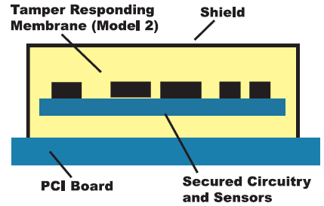
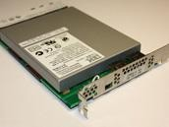
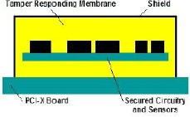
Trusted Hardware – Example
IBM 4765 Secure Coprocessor

Slide 49
Trusted Computing Group TCG History & Evolution
October 1999: TCPA formed
Trusted Computing Platform Alliance
Founders: IBM, HP, Compaq, Intel and Microsoft
2001: 1st TPM specification released
Trusted Platform Module
2002: TCPA changes its name to TCG
Trusted Computing Group
Industry standards organization
2003: TCPA TPM spec. adopted by TCG as TPM 1.2
2012: Draft TPM Specification 2.0 published
TPM 2.0 spec. not compatible with TPM 1.2 spec.
2015: Official TPM specification 2.0

Slide 50
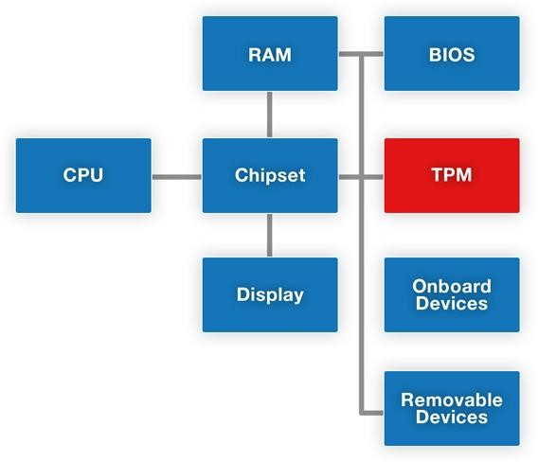
Pervasiveness of the TPM
The TPM chip sits
on the motherboard
Installed in 2 billion
devices per 2015
Relatively obscure technology for most people

Slide 51
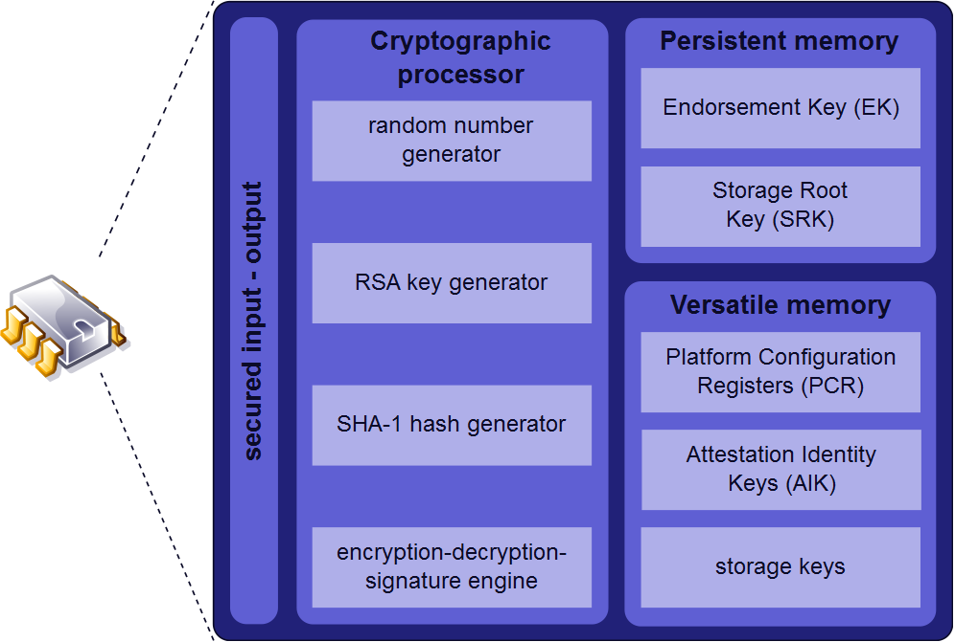
TPM 1.2 Functionality

Slide 52
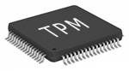
TPM usage
TPM is both the name of a standard and a chip
TPM chip at the heart of hardware / software approach to
trusted computing
Current TPM chips implement TPM spec. 2.0
Latest version of TPM spec. 2.0 is from 2015
TPM chip mounted on motherboard,
TPM equipped computing platforms
Laptops, servers, pads, mobile phones
Used by software platforms
Windows Vista / 7 / 8 / 10, Linux, and MAC OS
Supports 3 basic services:
Authenticated/measured boot,
Sealed Storage / Encryption
Remote attestation,
52

Slide 53
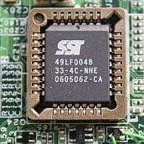
Boot protection
OS (i.e. Windows)
Drivers
OS Kernel
BIOS / UEFI
Processor Code
Application 1
Application 2
Application 3
BIOS /UEFI
Loaded by processor code at power-on
BIOS/UEFI initializes and identifies system devices such as display and keyboard
BIOS/UEFI then loads software (OS) held on
a peripheral device such as a hard disk
BIOS/UEFI firmware is stored in ROM
Boot protection
CRTM (Core Root-of-Trust for Measurement)
Boot protection focuses on verifying the integrity of the OS during boot.
CRTM can provide integrity assurance of OS
The usage of CRTM can be to check PCR or
to check Digital Signatures of software.
optional
53

Slide 54
Boot Protection with TPM
The CRTM is the initial code which starts running at CPU power-on.
The boot integrity depends on the CRTM integrity.
Multiple options for storing the CRTM, e.g. in CPU or external ROM
Multiple options for storing PCR, e.g. in TPM or in other ROM chip.
Drivers
PCR
(Platform Configuration Registers)
Hash values of known good software modules
Stored in TPM or CPU
Measure 5
Check PCR
6
OS Kernel
Measure
3
Check PCR
4
BIOS
CRTM
options
Measure
1
Check PCR
2
Processor Code
54

Slide 55

Boot Protection with UEFI
Unified Extensible Firmware Interface (replaces BIOS)
The CRTM is the UEFI code which starts at CPU power-on.
The boot integrity depends on the UEFI/CRTM integrity.
The root public key must be stored in CPU.
Drivers
Root Certificate with root public key
for validating DigSigs
Stored in CPU
Measure
3
Check DigSig
OS Kernel
4
Measure
1
Check DigSig
CRTM
UEFI
2
55

Slide 56
Two modes of boot protection
Secure boot with UEFI (not with TPM, see UEFI later)
The platform owner can define expected (trusted) measurements
(hash values) of OS software modules.
Hash values stored in memory signed by private PK (Platform Key).
Public PK stored in secure firmware on platform
Measured hash values can be compared with stored values.
Matching measurement values guarantee the integrity of the
corresponding software modules.
Boot process terminates if a measurement does not match the
stored value for that stage of the boot process.
Authenticated/Measured boot with TPM
Records measured values in PCRs and reports to remote party
Does not terminate boot if measured values are wrong
56

Slide 57
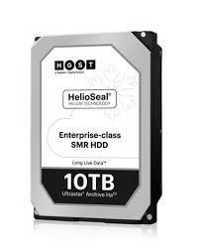
Sealed Storage / Encryption
Encrypts data so it can be decrypted
by a certain machine in given configuration
Depends on
Storage Root Key (SRK) unique to machine
Decryption only possible on unique machine
Can also extend this scheme upward
create application key for desired application version running on desired system version
Supports disk encryption
57

Slide 58



Remote Attestation
TPM can certify configuration to others
with a digital signature in configuration info
giving another user confidence in it
Based on Attestation Key (AK)
Remote parties can validate signature based on a PKI
Provides hierarchical certification approach
trust TPM, then trust the OS, then trust applications
System Remote party
Attestation about platform identity
and SW status
58

Slide 59
End of lecture
57

